Slide 1


EMPLOYEE ATTRITION ANALYSIS
George Mathew
20th September 2024

Slide 2
Outline
Executive Summary
Introduction
Methodology
Results
Conclusion

Slide 3
Executive Summary
Summary of methodologies
Data Collection through csv file downloaded using link for Exploratory Data Analysis and determining factors affecting attrition.
Data Wrangling after importing data into Power BI and using Power query for sampling data, dealing with Nulls and converting of certain data types.
Creating measures using DAX to calculate attrition-rate in case of different categories in the various parameters.
Exploratory Data Analysis by creation of visualization dashboards categorized into four major heads viz. classification as per gender, job role etc. and based on non-controllable / controllable parameters.
Summary of all results
Exploratory Data Analysis result.
Analysis of factors affecting attrition and make recommendations / suggestions.

Slide 4
Introduction
Project background and context
XYZ company which was established a few years back is facing around a 15% attrition rate for a couple of years. And it is majorly affecting the company in many aspects. In order to understand why employees are leaving the company and reduce the attrition rate XYZ company has approached an HR analytics consultancy for analyzing the data they have.
Task
Being in the HR analyst role in this project build a dashboard which can help the organization in taking data-driven decisions.

Slide 5
Section 1

Slide 6

Methodology
Executive Summary
Data collection methodology:
Data was collected using the download link provided.
Perform data wrangling
Wrangling done using Sampling data and dealing with Nulls, converting data types and creating of measures using DAX.
Perform exploratory data analysis (EDA) using dashboards visualisations.
Perform analysis of factors affecting attrition and make recommendations / suggestions
By preparing dashboards, categorising the visualisations under four major heads viz. classification as per gender, job role etc. and based on non-controllable / controllable parameters, recommendations / suggestions are made to help the organization in taking data-driven decisions.

Slide 7
Data Collection and its Presentation
Data was collected using the download link provided.
Inspecting Data: Check the types and initial content.
Wrangling done using Sampling data and dealing with Nulls.
Data Type Conversion: Convert fields to the appropriate types.
Aggregating Data: Create measures using DAX for calculating attrition-rate.

Slide 8
EDA with Data Visualization – Classification on Major Parameters
Bar Graphs: ​
Attrition by Gender
>> After plotting the graph, we observed that number-wise the attrition is higher in males (430) than in females (265).
To understand whether the attrition-rate gender-wise also follows the same trend, we calculated the attrition-rate gender-wise and found that the attrition-rate is higher in males (17%) than in females (15%)
Attrition by Department
>> After plotting the graph, we observed that number-wise the attrition is highest in Research & Dev. deptt. (443) followed by Sales deptt. (198) and then by HR (54).
To understand whether the attrition-rate department-wise also follows the same trend, we calculated the attrition-rate department-wise and found that the attrition-rate is highest in HR (29%) followed by Research & Dev deptt. (16%) and then by Sales deptt. (15%). The higher percentage in HR needs further analysis as it is observed that in HR the number of attrition under Job Role ‘Sales Executive’ is 23 of the total of 54 attritions. Either there is error in department.-wise, classification as we also find HR Job-Role in other departments as well or the Job Role needs to be focussed upon to understand the reasons.

Slide 9
EDA with Data Visualization – Classification on Major Parameters- contd/-
Bar Graphs: ​
Attrition by Job-Role
>> After plotting the graph, we observed that number-wise the attrition is highest in the ‘Sales Executive’ Job-Role (162) followed by Research Scientist (158) then by Laboratory Technician (122), Healthcare Representative (55), Research Director (54), Manufacturing Director (48), Manager (39), Sales Representative (36) and Human Resources (21) in descending order..
To understand whether the attrition-rate job-role-wise also follows the same trend, we calculated the attrition-rate job-role-wise and found that the attrition-rate is highest in the ‘Research Director’ Job-Role (23%) followed by Research Scientist (18%) then by Sales Executive (17%), Laboratory Technician (16%), Healthcare Representative (15%), Sales Representative (15%), Human Resources (14%), Manager (13%) and Manufacturing Director (11%) in descending order. When it comes to percentage-wise attrition the change in order is noticeable as far as the ‘Research Director’ Job-Role is concerned and it needs to be focussed upon.
Attrition by Monthly-Income-Range
>> After plotting the graph, we observed that number-wise the attrition is highest in the income range ‘25000 to 39999’ (158) followed by ‘40000 to 54999’ (148) then by ‘55000 to 69999’ (108), ‘10000 to 24999’ (103), ’145000 and more’ (58), ‘70000 to 84999’ (38), ‘100000 to 114999’ (34), ‘85000 to 99999’ (27), ‘130000 to 144999’ (18) and ‘115000 to 129999’ (3).
To understand whether the attrition-rate income-range-wise also follows the same trend, we calculated the attrition rate income-range-wise and found that the attrition-rate is highest in the income range ‘25000 to 39999’ (79%) followed by ‘40000 to 54999’ (74%) then by ‘55000 to 69999’ (54%), ‘10000 to 24999’ (52%), ’145000 and more’ (29%), ‘70000 to 84999’ (19%), ‘100000 to 114999’ (17%), ‘85000 to 99999’ (14%), ‘130000 to 144999’ (9%) and ‘115000 to 129999’ (2%).

Slide 10
EDA with Data Visualization – Non-controllable Parameters
Line Graphs: ​
Attrition by Distance From Home
>> After plotting the graph, we observed that graph is non-linear with non-linear variations. While the number of attrition of 113 is the highest where the distance from home is 2 (assuming the unit to be km), the next highest being 93 where the distance from home is 1 km. The next highest is a distant 60 where the distance from home is 10 km. So, overall, it is observed that the attrition is highest where the distance from home is at a lower range upto 2 kms. However, as the HR cannot have any say in the matter, so it has been categorised under non-controllable parameter.
Attrition by Percentage Salary Hike
>> After plotting the graph, we observed that graph is non-linear but is sloping downwards. While the number of attrition of 98 is the highest, where the percentage salary hike is 13%, the next highest is 90 where the percentage salary hike is 11% followed by the next highest being 86 where the percentage salary hike is 12% & 14%. The next is a distant 62 where the percentage salary hike is 15% and the lowest is 9 where the percentage salary hike is 24%. So, overall, it is observed that the attrition is higher where the salary hike ranges from 11% to 14%, while it decreases as the percentage salary hike reaches 15% and over. However, as the HR cannot have any say in the matter, so it has been categorised under non-controllable parameter.

Slide 11
EDA with Data Visualization – Non-controllable Parameters
Line Graphs:
Attrition by Years at Company
>> After plotting the graph, we observed that graph is non-linear with non-linear variations. While the number of attrition of 175 is the highest where the years at company is 1, the next highest being 79 where the years at company is 2. The next highest is 61 where the years at company is 5. While an unusual peak of 53 is where the years at company is 10, all others are below 50 and beyond 10 years at company the number of attrition is low at 6, 4, 3 in that range. So, overall, it is observed that the attrition is highest where the years at company is at a lower range upto 10 years. However, as the HR cannot have much say in the matter looking to the trend of employees with lesser years of service switching jobs after gaining little experience seeking higher salaries, so it has been categorised under non-controllable parameter.
Attrition by Total Working Years
>> After plotting the graph, we observed that graph is non-linear with non-linear variations. While the number of attrition of 118 is the highest where the total working years is 1, the next highest being 74 where the total working years years is 10. The next highest is 64 where the total working years is 6. While the number of attrition is 21 and above in other cases of total working years upto 11, the number of attrition in case of total working years above 11 years is below 21. So, overall, it is observed that the attrition is highest where the total working years is at a lower range upto 10 years. However, as the HR cannot have much say in the matter looking to the trend of employees with lesser years of service switching jobs after gaining little experience seeking higher salaries, so it has been categorised under non-controllable parameter.

Slide 12
EDA with Data Visualization – Controllable Parameters - Action HR
Bar Graphs: ​
Attrition by Business Travel
>> After plotting the graph, we observed that number-wise the attrition is highest in the travel-rarely category (460) followed by travel frequently (199) and lastly non-travel (36).
To understand whether the attrition rate travel category-wise also follows the same pattern, we calculated the attrition rate travel category-wise and found that the attrition-rate is highest in the travel frequently category (25%) followed by travel-rarely (15%) and lastly non-travel(8%). When it comes to attrition-rate the change in order is noticeable as far as the travel frequently category is concerned which needs to be focussed upon.
Attrition by Marital Status
>> After plotting the graph, we observed that number-wise the attrition is highest in the single category (350) followed by married (251) and lastly divorced (94).
To understand whether the attrition rate marital status-wise also follows the same pattern, we calculated the attrition rate marital status-wise and found that the attrition-rate is highest in the single category (25%) followed by married (13%) and lastly divorced (10%).

Slide 13
EDA with Data Visualization – Controllable Parameters - Action HR – contd/-
Bar Graphs: ​
Attrition by Work Life Balance
>> After plotting the graph, we observed that number-wise the attrition is higher in work life balance category ‘3’ (375) then in category ‘2’ (167), then in category ‘4’ (80) and lastly in category ‘1’ (73).
To understand whether the attrition-rate work life balance category-wise also follows the same trend, we calculated the attrition rate work life balance category-wise and found that the attrition-rate is highest in work life balance category ‘1’ (31%) then in category ‘4’ (18%), then in category ‘2’ (17%) and lastly in category ‘3’ (14%). Thus, we see that attrition-rate-wise work life balance category ‘3’ has the lowest rate while number of attrition-wise it has the highest figures. We find that the attrition-rate in all the category except category ‘1’ is around the average attrition-rate. The category ‘1’ needs to be looked in to. We find that Job-Role-wise ’Research Scientist’ is the highest number (17) under work life balance category ‘1’. Similar other factors like years at company, marital status also have a correlation.
Attrition by Training Times Last Year
>> After plotting the graph, we observed that number-wise the attrition is higher in training times last year category ‘2’ (273) then in category ‘3’ (253) then in category ‘5’ (51) then in category ‘4’ (47) then in category ‘0’ (30) then in category ‘1’ (29) and lastly in category ‘6’ (12).
To understand whether the attrition-rate training times last year category-wise also follows the same trend, we calculated the attrition-rate training times last year category-wise and found that the attrition is highest in training times last year category ‘0’ (19%) then in category ‘3’ (18%) then in category ‘2’ (17%) then in category ‘5’ (15%) then in category ‘1’ (14%) then in category ‘4’ (13%) and lastly in category ‘6’ (6%). Although the highest training times last year category ‘6’ has the least attrition-rate yet in other categories the variation in attrition-rate is not very significant.

Slide 14
EDA with Data Visualization – Controllable Parameters – Action HR & Employee
Bar Graphs: ​
Attrition by Job Satisfaction
>> After plotting the graph, we observed that number-wise the attrition is higher in job satisfaction category ‘3’ (214) then in category ‘1’ (194), then in category ‘4’ (152) and lastly in category ‘2’ (135).
To understand whether the attrition-rate job satisfaction category-wise also follows the same trend, we calculated the attrition-rate job satisfaction category-wise and found that the attrition-rate is highest in job satisfaction category ‘1’ (23%) then in category ‘3’ (17%), then in category ‘2’ (16%) and lastly in category ‘4’ (11%). Thus, we see that attrition-rate-wise job satisfaction category ‘4’ has the lowest rate. The number of attrition in job satisfaction category ‘1’ (194) and the attrition rate thereof (23%) points towards the fact that frequent job satisfaction survey and employee engagement can help reduce the attrition under this sub-category.
Attrition by Stock Option Level
>> After plotting the graph, we observed that number-wise the attrition is higher in stock option level category ‘0’ (311) then in category ‘1’ (263), then in category ‘2’ (84) and lastly in category ‘3’ (37).
To understand whether the attrition-rate stock option level category-wise also follows the same trend, we calculated the attrition-rate stock option level category-wise and found that the attrition-rate is highest in stock option level category ‘2’ (18%) then in category ‘0’ (17%), then in category ‘1’ & ‘3’ (15%). Thus, we see that attrition-rate-wise job satisfaction category ‘1’ & ‘3’ have the lowest rate.
The attrition-rate being near the average for almost all the categories, it appears that other factors have a overarching effect compared to the stock option level.

Slide 15
EDA with Data Visualization – Controllable Parameters – Action HR & Employee
Bar Graphs: ​
Attrition by Performance Rating
>> After plotting the graph, we observed that number-wise the attrition is higher in performance rating category ‘3’ (573) and lowest in category ‘4’ (122).
To understand whether the attrition-rate job satisfaction category-wise also follows the same trend, we calculated the attrition-rate performance rating category-wise and found that the attrition-rate is highest in performance rating category ‘4’ (18%) and lowest in category ‘3’ (16%).
The attrition-rate being near the average for both the categories, it appears that other factors have a overarching effect compared to the performance rating.
Attrition by Job Involvement
>> After plotting the graph, we observed that number-wise the attrition is higher in job involvement category ‘3’ (388) then in category ‘2’ (178), then in category ‘4’ (77) and lastly in category ‘1’ (52).
To understand whether the attrition-rate job satisfaction category-wise also follows the same trend, we calculated the attrition-rate job involvement category-wise and found that the attrition-rate is highest in job involvement category ‘1’ (22%) then in category ‘4’ (18%), then in category ‘2’ (16%) and lastly in category ‘3’ (15%). Thus, we see that attrition-rate-wise job involvement category ‘1’ has the highest rate. Although number-wise, the attrition in job involvement category ‘1’ (52) yet the attrition rate thereof (22%) points towards the fact that frequent job involvement survey and taking care of other parameters in addition to employee engagement can help reduce the attrition under this sub-category.

Slide 16
Section 2

Slide 17
Results
Exploratory data analysis results

Slide 18
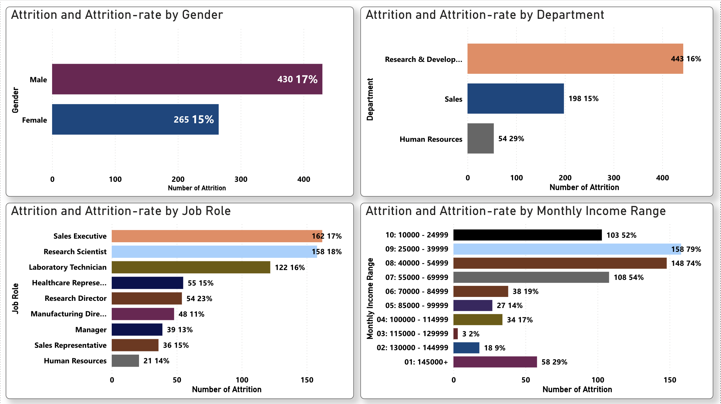
Attrition by Gender_Department_Job Role_Mnthly Income

Slide 19
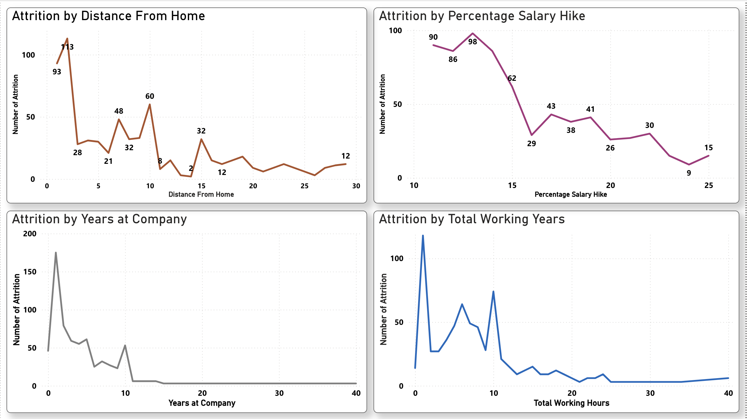
Attrition_Non_controllable_Parameters

Slide 20
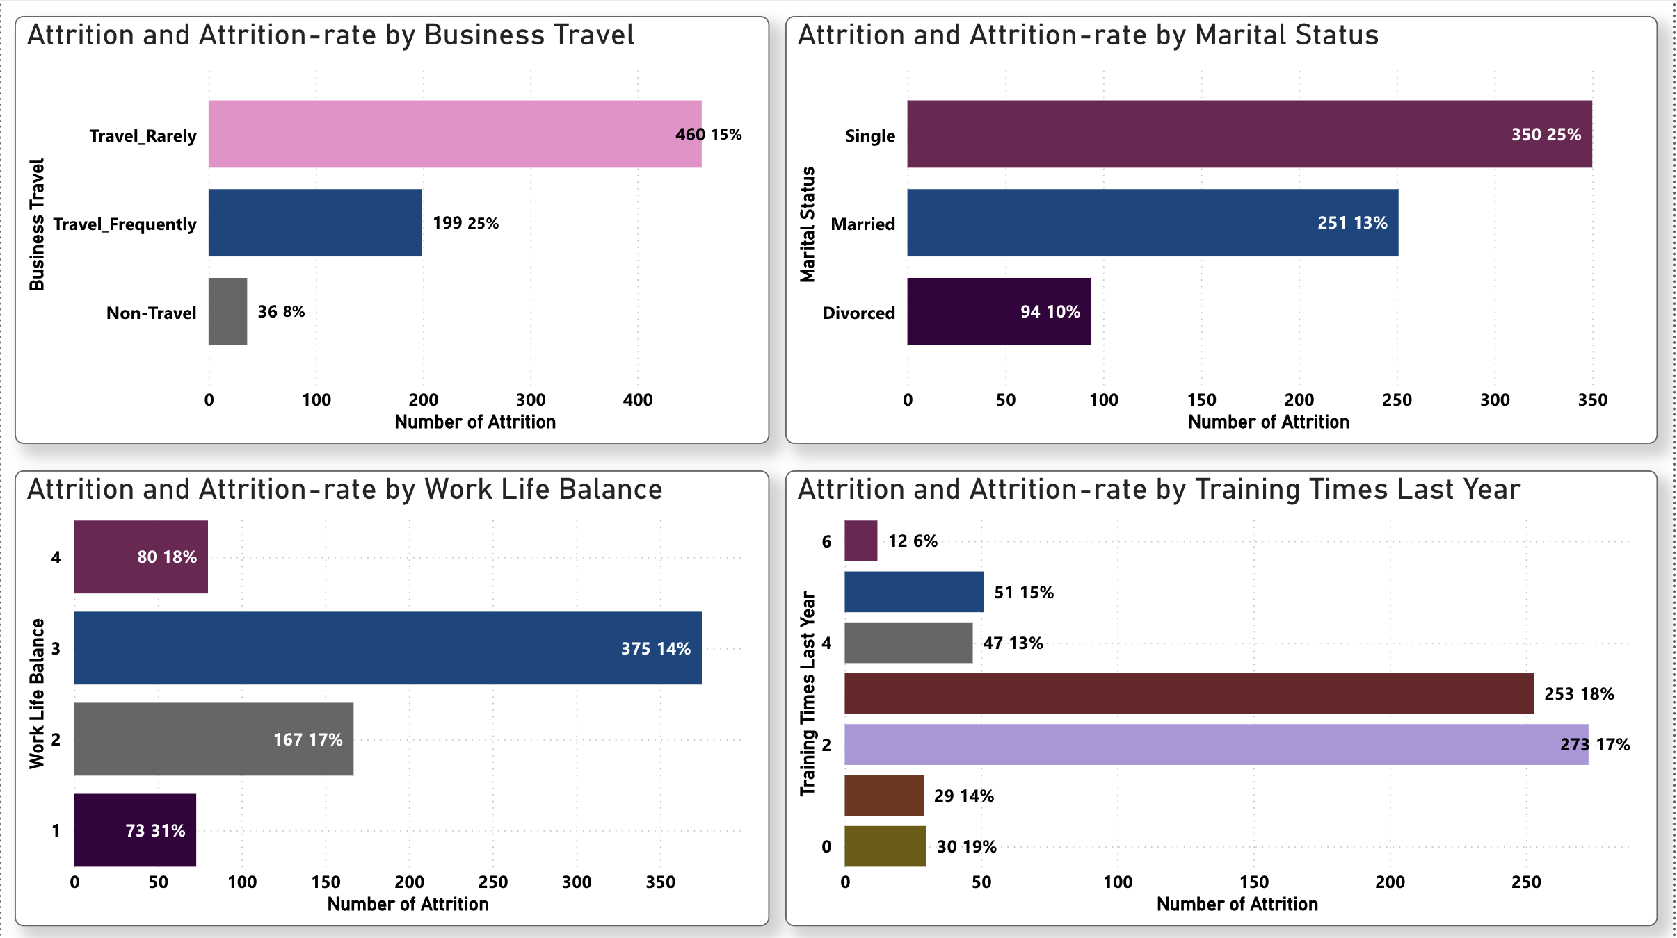
Attrition_Controllable_Parameters_Action HR

Slide 21
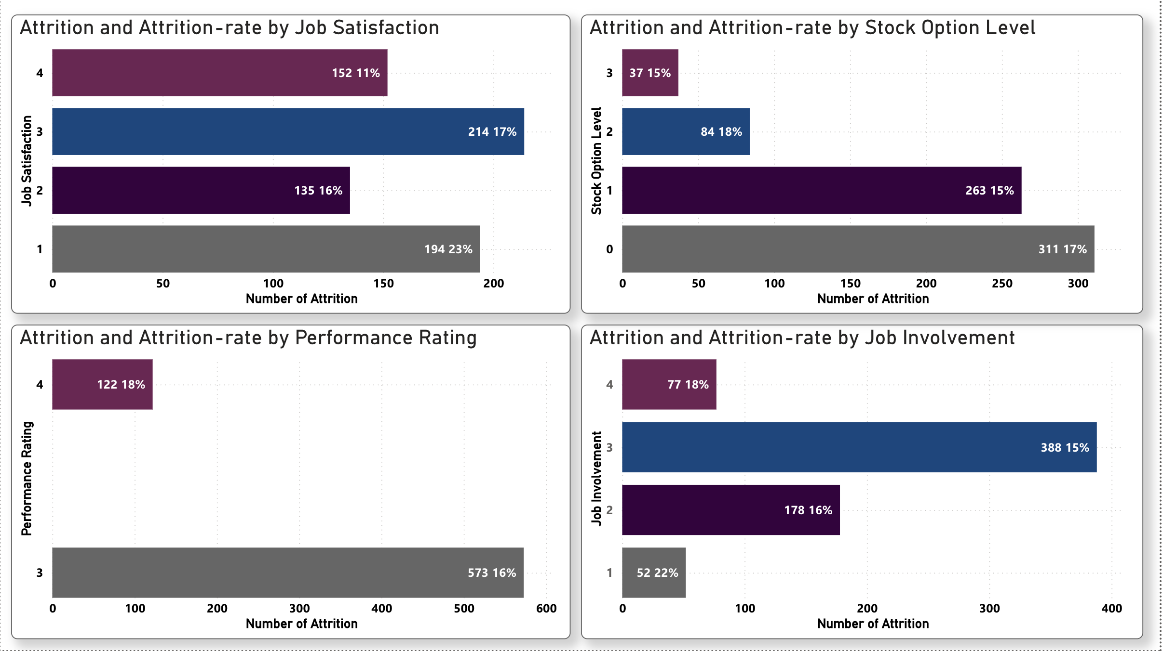
Attrition_Controllable_Parameters_Action_HR_&_Employee

Slide 22
Section 3

Slide 23
Conclusions
At the beginning of the project, we defined the tasks that were to be performed.
Task
Being in the HR analyst role in this project build a dashboard which can help the organization in taking data-driven decisions.
Dash boards categorisation was done into four major areas viz :
i. Classification of attrition on Majorly independent Parameters
ii. Classification of attrition on Non-controllable Parameters
iii. Classification of attrition on Controllable Parameters where Action by HR is suggested
iv. Classification of attrition on Controllable Parameters where Action by HR & Employee is suggested

Slide 24
Conclusions contd/-
Analysis of the visualisations created in the dashboard was done. Based on the observations of the attrition and attrition-rates under different categories of the various parameters the areas of concerns are listed below and the suggestions that would help reduce the attrition rate are also appended.
Identifying risk factors for employee attrition
There are signs that are revealed from the observations of the Visualisations to help the HR team identify where the company is at risk of high attrition that can potentially be detrimental to the business:
The attrition by gender-wise bar graph although gives a pattern yet if the gender and marital status are taken together and analysed then based on the understanding it will be useful to take suitable steps to reduce attrition.
The higher percentage in HR department needs further analysis as it is observed that in HR the number of attrition under Job Role ‘Sales Executive’ is 23 of the total of 54 attritions. Either there is error in department.-wise, classification or the Job Role needs to be focussed upon to understand the reasons. The attrition-rate in HR deptt (29%) appears skewed due to the contribution by ‘Sales Executive’ Job Role while the overall attrition-rate of ‘Sales Executive’ Job Role is 17 %.
High attrition in departments can be taxing for managers. They might have to find additional staff to cover shifts during vacancies or perform lower-level worker tasks to cope with understaffing. Critical incidents may also occur resulting from team members’ mistakes that tie up the manager’s time in remedying these situations.
When it comes to attrition-rate by Job-Role, the number of attrition by Job-Role is noticeable as far as the ‘Research Director’ Job-Role is concerned and it needs to be focussed upon as the attrition-rate is 23% which is quite higher than the average attrition-rate.

Slide 25
Conclusions contd/-
Suggestions based on the observations :
When it comes to attrition-rate by Business travel, the number of attrition is noticeable as far as the ‘travel frequently’ category is concerned, and it needs to be focussed upon as the attrition-rate is 25% which is quite higher than the average attrition-rate. Either employees who travel frequently need to be incentivised with some discomfort allowance or the travelling job need to be realigned so that the frequency of travel is not a irritant to the employee leading to attrition.
It is observed that the attrition-rate marital status-wise is highest in the single category (25%) as against the overall average of 16%. Although having young staff in the rolls is beneficial as far as containing the staff expenses is concerned but if the understanding gained from the analysis of attrition-rate marital status-wise is applied at the time of recruitment the company can prefer married candidates if other eligibility criteria and performance in test and interview are equal, to reduce the attrition-rate.
The number of attrition in job satisfaction category ‘1’ (194) and the attrition-rate thereof (23%) points towards the fact that frequent job satisfaction survey and employee engagement can help reduce the attrition under this sub-category.
It is observed that the attrition-rate-wise job involvement category ‘1’ has the highest rate. Although number-wise, the attrition in job involvement category ‘1’ (52) is comparatively not large yet the attrition rate thereof (22%) points towards the fact that frequent job involvement survey and taking care of other parameters in addition to employee engagement can help reduce the attrition under this sub-category as declining employee engagement or lower job involvement plays a huge role in employee attrition. When employees lose interest in their jobs, they become disconnected from their peers and managers ; and are less productive too.

Slide 26
THANK YOU

